Slide 1
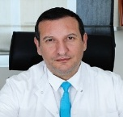
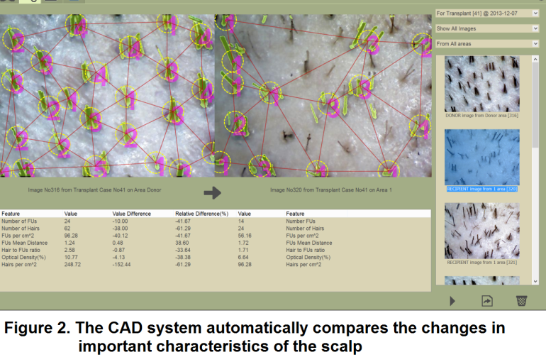
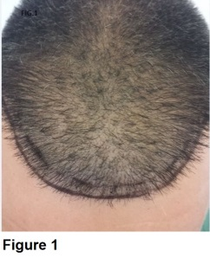
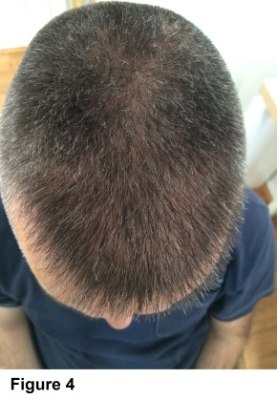
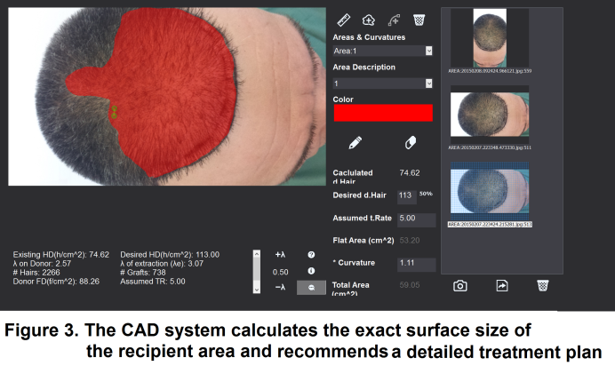
An Application of a Computer Aided Diagnosis (CAD) and Treatment Planning System in FUE Harvesting Procedure. Design, Review and Practical Evaluation
DISCLOSURES:
Authors have no relevant financial relationships or conflict of interest to declare
Georgios Zontos, George Nikiforidis
Department of Medical Physics, School of Medicine, University of Patras, Greece
Material/Methods
A 47 year old patient visited our clinic in 2014 looking for a solution for his hair loss problem. As it is illustrated in Figure 1 the patient had thinning hair at the frontal part of the head. To quantify the extent of thinning, micrographs were taken from both the donor and problematic area, with a high resolution USB camera. The pictures were processed by the CAD system which calculated the decrease in hair quantity in the problematic area.
Comparing microphotographs from the donor and recipient area as it is shown in Figure 2, the system precisely assessed that the hair density had decreased by 61.29%. Similarly, the system measured the curvature factor of the recipient area and found the total surface size to be 59 cm² and the optimal number of hair follicles to be 2266 which corresponds to 738 grafts (Fig.3)
G. Zontos, MD, PhD
Objective
We present a specifically designed software system that offers the physician the capability:
To archive patient data.
To precisely calculate the degree of hair thinning
To use digital trichometry
To design the individual patient treatment planning.
To constantly monitor each patient follow up.
To quantify the patient outcome.
The efficiency of the system in diagnosis ,treatment and postoperative follow up is evaluated in a clinical case of a patient who underwent an FUE hair transplantation.
Conclusion
The CAD system aids the physician to estimate the correct number of hairs/grafts required for an optimal aesthetic result. Equally, the use of an integrated CAD system in hair restoration could prove to be a very useful tool in both diagnosis and follow up treatments because of its high degree of precision.
Results/Discussion
1) The final result of the patient is shown in Figure 4. The trend-line of monitoring changes in hair density for all follow up data can be seen easily in a diagram. (Fig5) .

